Slide 1

Presentation on
CHITTI ROBOT
Presented By :
1. G.LOHITHA
2. B.SAHAJA
3. M.LAMI PRASANNA
4. N.DHARANI
5. A.YAMINI
Guided By :
Mr. V.AKSHITH NAG
Batch No : 05 Date: 28-03-2026
Dept. of Computer Science & Engineering

Slide 2
Index
Abstract
Introduction
Literature Survey
Problem Definition
Existing work
Proposed Work
Hardware and Software Specifications
Project Description /Modules
Results and analysis
References
Question Answer Session
Dept. of Computer Science & Engineering

Slide 3
Workforce Management
Task Allocation
Real-Time Tracking
Automation
Web Application
Abstract:
To automate workforce management processes
To reduce manual work and errors
To improve task allocation efficiency
To provide real-time tracking of workers
To manage customer requests effectively
To enhance productivity and decision-making
Keywords:
Workforce Management
Task Allocation
Real-Time Tracking
Automation
Web Application
Dept. of Computer Science & Engineering

Slide 4
Introduction
The Workforce Management System (WFM) is a web-based application designed to manage and optimize workforce operations in an organization.
It helps administrators efficiently handle workers, customers, task assignments, and service requests in real-time.
This system provides a centralized platform where all workforce-related activities such as worker availability, request management, and task progress can be monitored and controlled.
This project focuses on creating a smart system to manage workforce activities easily
It ensures better coordination between admin, workers, and customers
The system helps in organizing tasks and improving overall performance
Dept. of Computer Science & Engineering

Slide 5
Literature Survey
Traditional workforce management systems mainly rely on manual processes, which lead to inefficiency and errors
Existing digital systems provide basic task management, but lack real-time tracking and proper coordination
Some applications focus only on employee management without integrating customer requests
Modern systems use web-based technologies to improve accessibility and centralized control
Research shows that automation in workforce systems helps in reducing workload and improving productivity
However, many existing solutions are complex, costly, or not suitable for small organizations
This project aims to provide a simple, efficient, and cost-effective workforce management solution
Dept. of Computer Science & Engineering

Slide 6
Problem Definition:
In many service-based organizations, workforce management is still handled using manual or semi-digital methods, leading to inefficiency, lack of coordination, and poor tracking of tasks and workers.
There is no centralized system to manage workers, customer requests, and task assignments in real-time. As a result:
Task allocation becomes slow and unorganized
Worker availability is not tracked properly
Customer requests are delayed or mismanaged
There is no real-time monitoring of task progress
High chances of human errors and data inconsistency
Communication gap between admin, workers, and customers.
Dept. of Computer Science & Engineering

Slide 7
Existing work:
In traditional systems:
Data is managed manually
No real-time tracking
Task assignment is inefficient
High chances of errors
Time-consuming processes
Dept. of Computer Science & Engineering

Slide 8
Proposed work:
The proposed system solves these issues by:
Automating workforce operations
Providing a real-time dashboard
Efficient task allocation
Easy data management
Improved communication
Dept. of Computer Science & Engineering

Slide 9
Hardware Specifications:
Processor: Intel i3 or above
RAM: 4GB minimum
Storage: 500GB
Internet connection
Software Specifications:
Operating System: Windows/Linux
Frontend: HTML, CSS, JavaScript
Backend: Python (Django)
Database: SQLite / MySQL
Browser: Chrome / Edge
Dept. of Computer Science & Engineering

Slide 10
Project Descriptions/ Modules:
Admin Module:-
Login authentication
Dashboard overview
Manage workers and customers
Assign tasks
Monitor activities
Worker Module:-
View assigned tasks
Update task progress
Submit time-off requests
Update availability status
Customer Module:-
Register/login
Create service requests
Track request status
Provide feedback
Dept. of Computer Science & Engineering

Slide 11
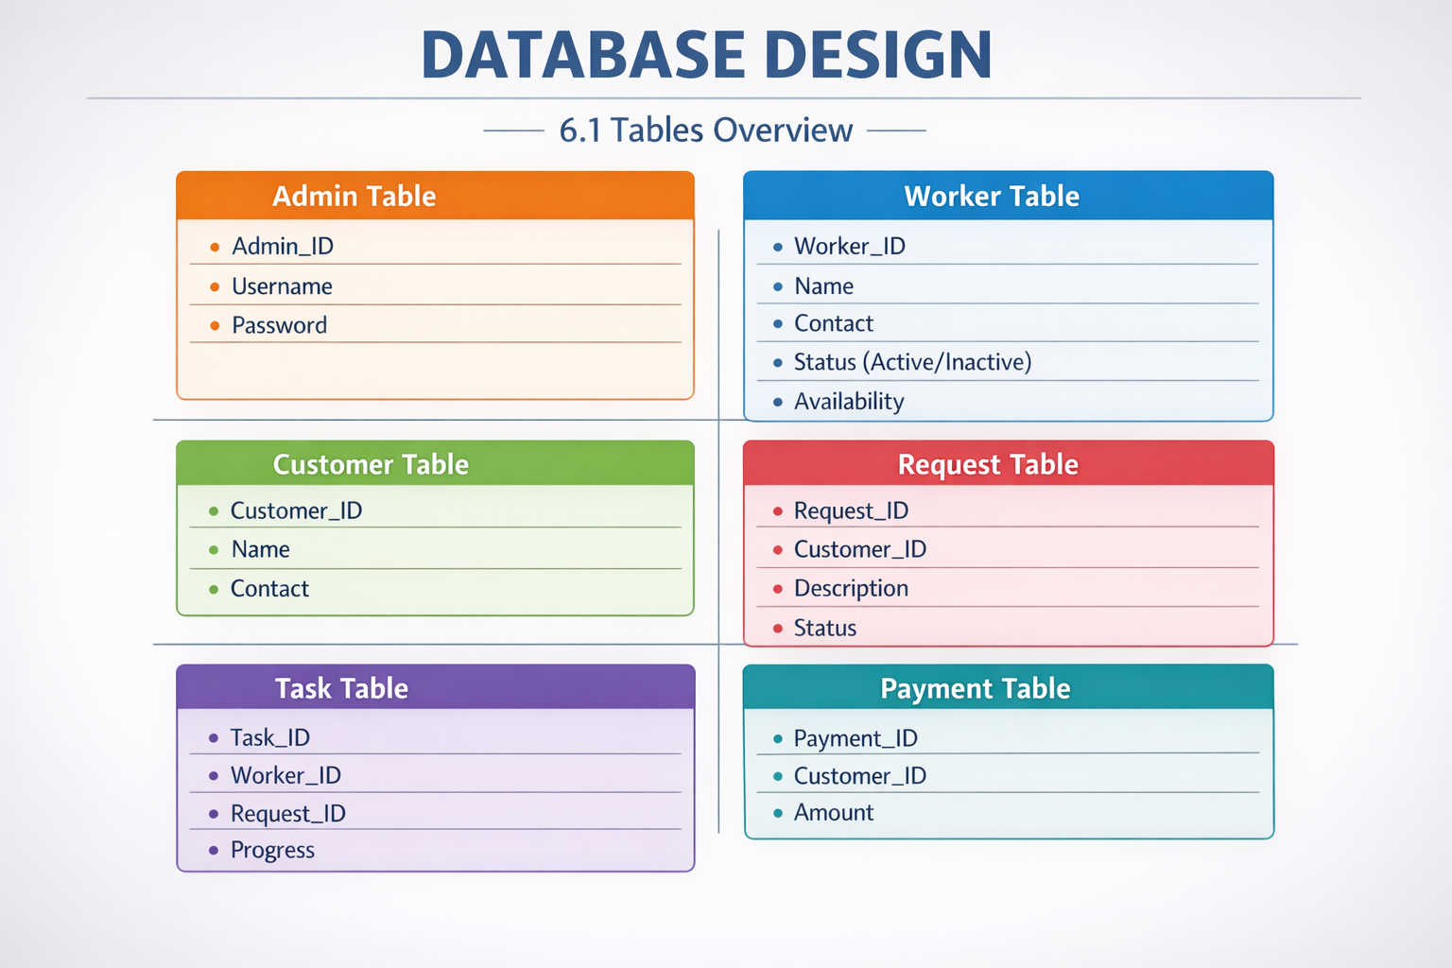
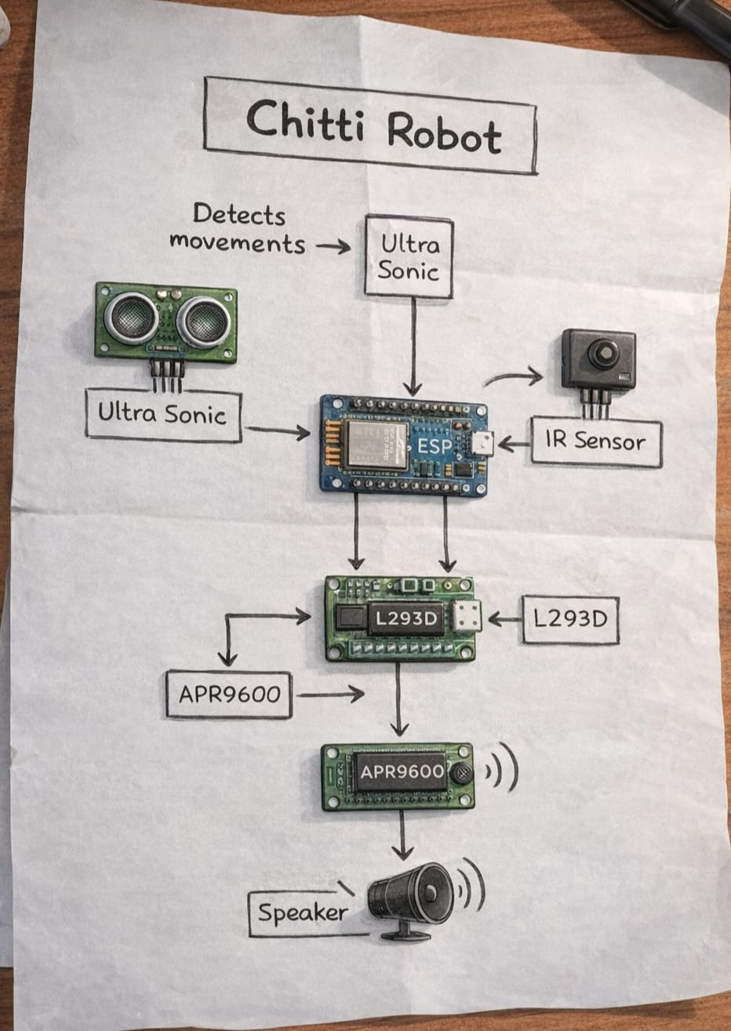
Results and Descriptions:
Dept. of Computer Science & Engineering

Slide 12
Queries
???
Dept. of Computer Science & Engineering

